Slide 2


Your vision, your results, your cloud
Datacenter Migration to Azure
Mohamed Garrana
Cloud Solution Architect
MEA HQ
Notes:
Turn your idea into a new app, reimagine an existing system, or create a hybrid cloud application with confidence, no matter the platform or where you are on the journey to the cloud.

Slide 3
AGENDA
Agenda
DC modernization Big picture
DC Assessment using Microsoft and 3rd party tools
C3 DC migration assessment in depth { Assessment pitch , Azure pitch , Deliverables and expectation }
C3 DC migration assessment proposal walkthrough

Slide 4
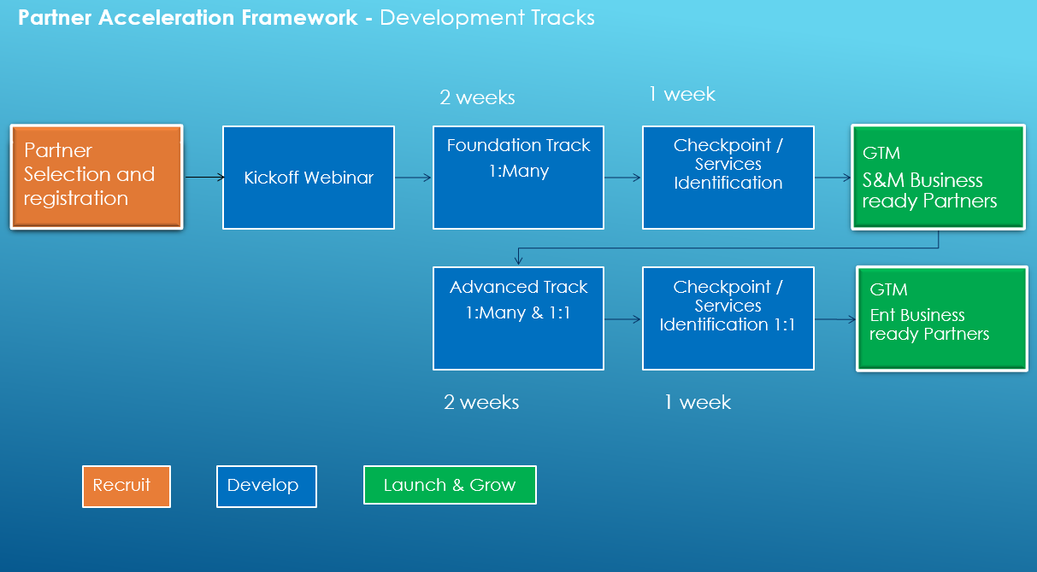
MEA Partner Acceleration Framework

Slide 5
Technical Delivery
Pre-Sales
Title | Link | Duration
Microsoft Azure essentials | https://linuxacademy.com/azure/training/course/name/microsoft-azure-essentials | 5 hours
Azure Migration Overview | https://channel9.msdn.com/Blogs/Hybrid-Cloud/Migration?term=migration | 15 minutes
Azure Migration Deep Dive | https://channel9.msdn.com/events/Ignite/Microsoft-Ignite-Orlando-2017/BRK2233?term=migration | 1 hour
Azure Migrate Service | https://channel9.msdn.com/Shows/Azure-Power-Lunch/AzureMigrateService | 30 minutes
Cost savings with Azure Virtual Machines | https://channel9.msdn.com/events/Ignite/Microsoft-Ignite-Orlando-2017/BRK3178?term=cost | 1.5 hour
Getting started with Azure backup | https://blogs.msdn.microsoft.com/azuregov/2017/02/16/getting-started-with-azure-backup-vaults-policies/ | 1 hour
Cloud Migration Site | https://azure.microsoft.com/en-us/solutions/cloud-migration/ | Reference
Azure Migration Datasheet | https://aka.ms/azuremigration_datasheet | Reference
Azure Migration Overview Guide | https://aka.ms/azuremigration_overview | Reference
DC Transformation Partner Resources | https://www.microsoftpartnerserverandcloud.com/Pages/practice.aspx?page=15 | Reference
Title | Link | Duration
implementing Microsoft Azure Infrastructure Exam 70-533 | https://linuxacademy.com/azure/training/course/name/implementing-microsoft-azure-infrastructure-exam-70-533-prep | 32 hours
Migration to Azure using ASR | https://channel9.msdn.com/events/Ignite/Microsoft-Ignite-Orlando-2017/BRK3243?term=migration | 1 hour
Importing an on-premises VM into Azure | https://channel9.msdn.com/Shows/Azure-Power-Lunch/Importing-an-on-premises-VM-into-Azure | 30 minutes
Azure Site Recovery Deep Dive | https://channel9.msdn.com/Shows/Azure-Power-Lunch/Azure-Site-Recovery | 1 hour
Azure Migration Technical Whitepaper | https://aka.ms/azuremigration_twp | Reference
DC Transformation Partner Resources | https://www.microsoftpartnerserverandcloud.com/Pages/practice.aspx?page=15 | Reference
Azure ASR Architecture | https://docs.microsoft.com/en-us/azure/site-recovery/concepts-vmware-to-azure-architecture | Reference

Slide 6
Migration Framework & Methodologies

Slide 7
What’s Driving Migrations?
Software and hardware refresh
Security threats
Urgent capacity needs
Compliance
Quickly integrate acquisitions
Application innovation
Migration triggers
Software end of support
Datacenter contracts expiry

Slide 8
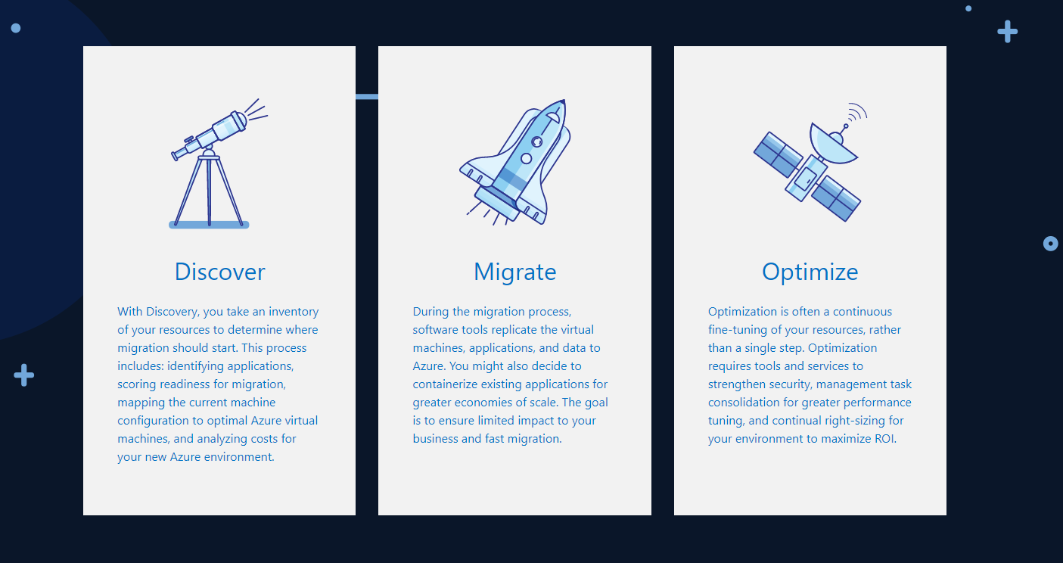
Three Steps Approach

Slide 9
A simpler approach to migration
Assess
Migrate
Optimize
Automated workload and data discovery
TCO and ROI analysis
Recommendation reports
Effortless app, virtual machine, and workload migration to Azure
Convert existing .NET applications to containers
Your choice of Azure database destination
Continual health, performance, and cost management
Access to advanced features in data services
Application analysis for optimal PaaS migration
Notes:
Working with customers and partners, Microsoft has developed a proven approach to migration that reduces risk and increases the chance of both a successful proof of concept and a clear path to additional migration opportunities. Following these steps, you get a clear picture of existing computing resources and dependencies, what will be needed on the Azure side, and what you can expect for costs. More details are on the following pages.

Slide 10
Migration Framework
Assessment
Migrate
Optimize
Discover
Roadmap
Build
Transition
Stabilize
Monitor
Portfolio Assessment
TCO Analysis
Security Requirements
Dependency Mapping
Grouping and Prioritization
Design& Architecture
Detailed Migration Schedule
Tool Selection
Create Azure environment
Replicate via ASR
Integrate applications and networks
Verification
POC Test and QA
User Acceptance
Staging
Cutover and Decommission
Training
Configuration management
ID Management
DevOps Automation
Cloud Monitoring
Cost/Use Optimization
Assessment & Migration tools, Monitoring, Management, Optimization, ITSM & Automation tools
Services Provider Billing and Operations Management & Automation, CSP integration
Notes:
Underneath this there are more details and levers, based on what we’ve seen in the market with other partners Migration Practices as well as what we do in house with our MCS Migration Practice
We’re currently developing the technical IP to guide partners on how to deliver on all of these steps, as well as the tooling to use (we’ll provide some subsidized licensing perhaps)
Provides a structure for delivering a broad portfolio of strategic guidance and tactical engagement of resources to drive realization of modern, digital, cloud-enabled and cloud-resident services and systems.

Slide 11

Types of Migrations
Rehost:
i.e. redeploy applications to a different (newer) hardware environment. Rehosting an application
without making changes to its architecture can provide a fast cloud migration solution. IaaS
Refactor:
i.e. run applications on a cloud provider’s infrastructure. Applications/workloads may need to be
modified slightly to run on the cloud provider’s platform. PaaS / Containers
Revise:
i.e. modify or extend the existing code base to support modernization requirements,
then use rehost or refactor options to deploy to cloud.
Rebuild:
i.e. rearchitect the solution. Discard code of existing application/solution and leverage newer
and innovative cloud services (like PaaS)
i.e. discard an existing application (or set of applications) and use commercial software
delivered as a service (SaaS)
Replace:
Retire/Retain:
i.e. discard completely or do not move. Some applications may not be used by anyone or
others may be simply impossible to move!

Slide 12
A different view of our Tactical approach
Approach:
From…
Office servers
Portals and SPS
Any relationship mgmt
Active source control
Data warehouses
Industry standard verticals
…To
Office 365
SharePoint Online
CRM Online
VSTS
ADL + PowerBI
Best 3rd-party SaaS
Retire it, right-size, eliminate environments
30%
Use or convert to a SaaS (1st or 3rd party) solution
15%
Use or convert to a SaaS (1st or 3rd party) solution
Expose functionality in existing SaaS/PaaS solution
Azure IT roadmap
Convert to Azure PaaS solution
First to move
Basic web apps
Advanced portals
Any new solutions
Any re-architected solutions
Next to move
High I/O OLTP
Regulatory and high business impact
50%
Optimize for and move to Azure IaaS VM
No change, lift ‘n shift to IaaS
Remain on-premises
HVA systems
PKI systems
Legacy source control
5%

Slide 13
Lift and Shift (Apps, Virtual Machines, Workloads)
Lift and Shift is great when you
Want to avoid the burden of owning on-premises servers and datacenters. The cost and risk of maintaining the facilities are high.
Want to move to cloud to lower your maintenance costs by taking advantage of cloud infrastructure.
Need a scale-on-demand capacity with no change in application environment needed.
Want to have data disaster recovery in cloud.
Notes:
There are many scenarios under which Lift and Shift is the best approach:
Want to move to Cloud as-is to lower your maintenance costs taking advantage of cloud infrastructure
Want to avoid the burden of owning on-premises servers and data centers.
Need a scale-on-demand capacity with no change in application environment needed.
Need disaster recovery

Slide 14


Understanding a Typical On-Premise to Cloud Migration
MIGRATION PROCESS
DECOMMISSION
Azure
Hybrid
Partner cloud
Customer Cloud
1.
1
Discover customer’s
on-prem footprint (VMs, networks, apps etc.)
2
Map dependencies and determine network topology
3
Recommend optimization path for workloads, cost modeling
4
Determine best cloud computing service model
5
Provide cloud migration strategy and plan

Slide 15
Partner Offering Progression
Managed Services based recurring revenue
Advanced Managed Services
(Big Data, Advanced Analytics/AI, Dev Ops, IoT)
Workload optimization
(e.g.: IaaS – PaaS, Application re-architecture)
Capacity & Capability
Cloud workload management services
(e.g.: Monitoring, Support, Security)
PARTNER’S AZURE MIGRATION OFFERING JOURNEY
Assessment & Migration
(Lift & Shift, Redeploy, DR)
Offering progression over time
*Source: HMSP partner interviews; partner may team up with SI/subcontract

